Slide 1
MBA 6816 Case Information
PGA of America

Slide 2
Case Focus
PGA of America is having a difficult time getting PGA professionals (i.e., PGA Members) to adopt the PGA Family program at their local course. Some PGA professionals are doing one of the following: (1) adopting the program under the PGA Family logo, (2) adopting the program as a separate program not under the PGA Family logo, or (3) not adopting the program in any form.
What could the PGA of America do that would make PGA Family into “something bigger" that would motivate PGA professionals (2) and (3) above to adopt the program at their local course under the PGA Family logo?

Slide 3
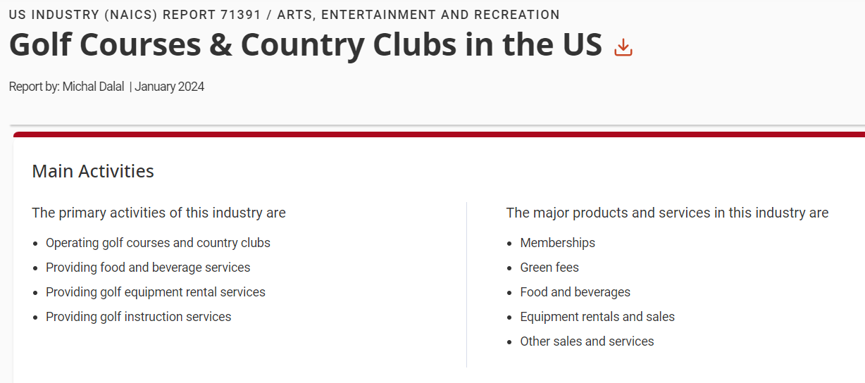
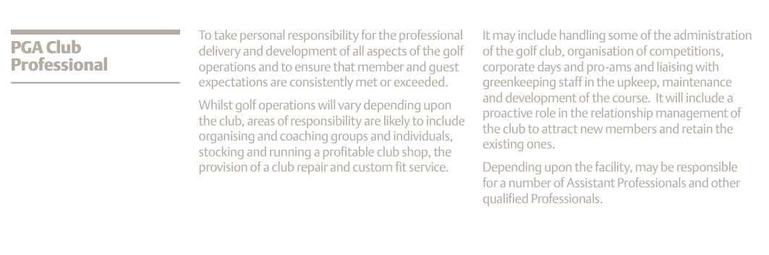
PGA Professional’s World
Source: PGA Role Descriptors, 1st Edition, PGA of America at https://www.pga.info/media/1753/14pgaroledescriptorsweb1306.pdf
PGA professional is typically hired by a golf course.
What are two key objectives of a golf club (the business) that could be impacted by PGA Family?
What are two roles of a PGA Professional could be fulfilled by a PGA professional participating in PGA Family?
Notes:
Group Response:
Key
-Members (Generational), having PGA family bring their family, that creates future member and nostalgia factor
-Events – If PGA family hosts upcoming events that influence more people to come out to the course and drive more foot tragic.
COMMENT: be more specific; what kind of “business” will this deliver?
What 2 roles?
-Exposure, the social influence of the professional being in the game.
-Skill Development - watching a professional play beside you.
COMMENT: I don’t see any of the roles you identify in the job description for the PGA Club Professional above. Please align your roles with the job description.

Slide 4
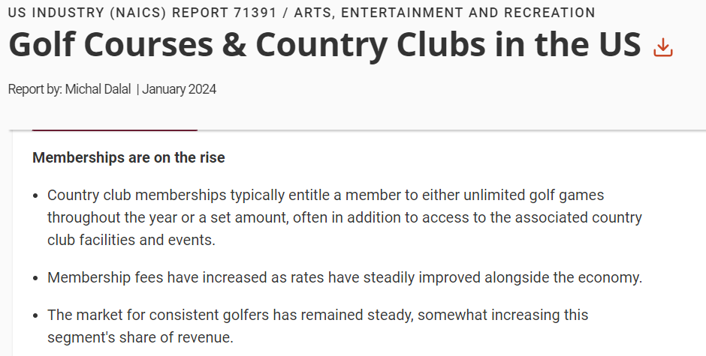
PGA Professional’s World
Source: IBISWorld - Industry Market Research at UCF Library, https://guides.ucf.edu/az.php?s=12215
What is one way PGA Family could be designed to potentially impact membership?
Notes:
Group Response:
-Drive membership because of the memories created with family members. Regardless of skill, membership will be viewed as a way to spend quality time with family while developing skills in golf.
COMMENT: Nostalgia builds over time. How would you use nostalgia for beginning golfers? Nostalgia is powerful but I’m not seeing the opportunity here. What am I missing?

Slide 5
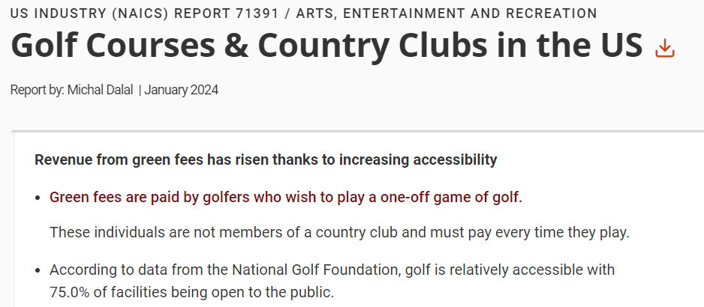
PGA Professional’s World
Source: IBISWorld - Industry Market Research at UCF Library, https://guides.ucf.edu/az.php?s=12215
What is one way PGA Family could be designed to potentially impact green fee revenue?
Notes:
Group Response:
- Discount or Bundling (Family Memberships)
-Budlings Rates for rented equipment and playing the course
COMMENT: what does this look like? What get’s bundled? Details needed.

Slide 6
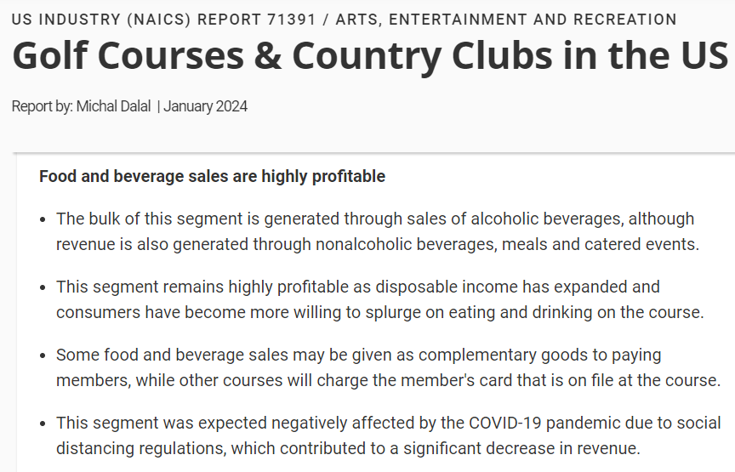
PGA Professional’s World
Source: IBISWorld - Industry Market Research at UCF Library, https://guides.ucf.edu/az.php?s=12215
What is one way PGA Family could be designed to potentially impact food and beverage?
Notes:
Group Response:
- Family style meals (restaurant)
COMMENT: Not seeing this as something new. Don’t most restaurants already cater to families. Details needed to better understand your thinking here.

Slide 7
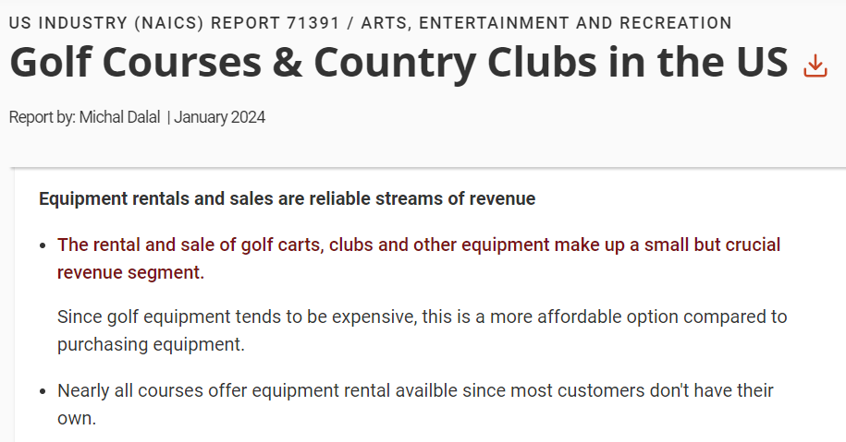
PGA Professional’s World
Source: IBISWorld - Industry Market Research at UCF Library, https://guides.ucf.edu/az.php?s=12215
:
What is one way PGA Family could be designed to potentially impact rental and sales of golf equipment?
Notes:
Group Response:
-Play and rental bundles
- Kids club rentals are free
- Long period rentals, bundles, and discount rates – increase loyalty through accessibility and retention

Slide 8
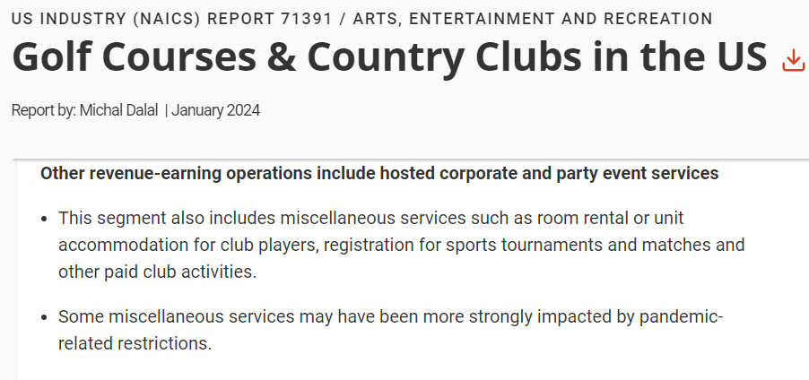
PGA Professional’s World
Source: IBISWorld - Industry Market Research at UCF Library, https://guides.ucf.edu/az.php?s=12215
What is one way PGA Family could be designed to potentially impact other revenue-earning operations?
Notes:
Group Response:
- PGA family can be gamified competitions such as some of the skills we learned at Fairways to Leadership (minigames)
- Scramble tournaments for families
COMMENT: FWTL was all beginners but in this there will be a mix of experienced and beginning players in the family. How would you address these different skill levels.

Slide 9
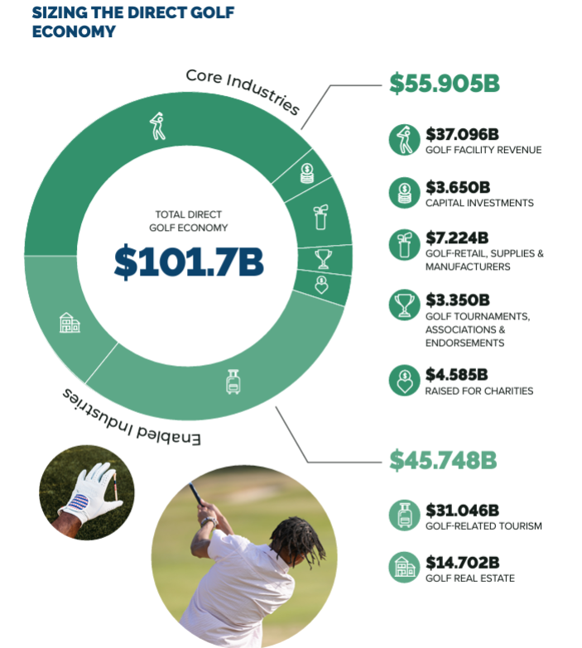
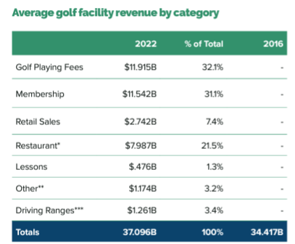
PGA Professional’s World
Source: Golf Impact Report 2022 at https://www.ngf.org/wp-content/uploads/2023/05/AGIC_Economic-Impact-Report-2023.pdf
How could place of PGA Family be designed to positively impact one of these areas of economic activity? What would access look like? What would assistance look like? What would assortment look like? What would aesthetics look like?
Notes:
Group Response:
PGA Family can be hosted on Saturdays (allows more experienced golfers to have their own space on Sunday)
- Access – allows families to have an inviting environment for them / restaurant space for family style meals
- Assistance – coaches available for those who want to develop skill further. / Standard employees surveilling making sure everyone is behaving accordingly and following rules
- Assortment- Having a vast variety of clubs , memberships and balls to personalize the experience and offer enough supplies for families to have a good time
- Aesthetics – Using nostalgia, sensory and visual appeals to create a feeling for the customers who come to PGA family and create lasting memories for families.
COMMENT: This is the level of detail needed in all responses. Again, I’m struggling with the nostalgia idea. Not saying don’t do it but make sure you describe why and how this effect will occur.

Slide 10
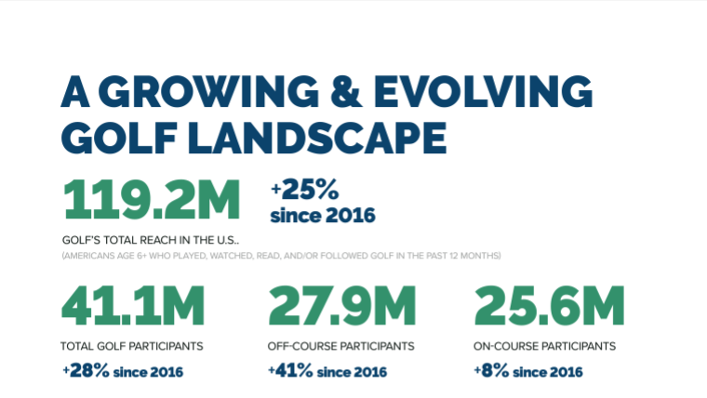
PGA Professional’s World
What are two implications of these numbers related to PGA professional adoption of PGA Family?
For implications that are an opportunity, how could promotion be used to maximize their impact?
For implications that are a threat, how could promotion be used to minimize their impact?

Slide 11
Place recommendations related to golf course access, assistance, and aesthetics.
What would you recommend for designing the following aspects of place for PGA Family in ways that would promote PGA professional adoption of PGA Family:
Access
Assistance
Aesthetics
Think about the role of the PGA professional as an intermediary for the PGA and for families.

Slide 12
Product recommendations related to “Play” and “Learn” program offerings.
What would you recommend for designing the following aspects of service offered by PGA Family in ways that would promote PGA professional adoption of PGA Family:
Play
Learn
Think about the need for redesigning current offerings and/or adding new offering related to Play and Learn using the attributes-consequences-values framework.

Slide 13
Promotional recommendations related to paid, owned, and earned media.
What would you recommend for designing the following aspects of promotion for PGA Family in ways that would promote PGA professional adoption of PGA Family?
Paid Media
Owned Media
Earned Media
Think about the need for a push and/or pull strategy approach that emphasized marketing PGA Family to professionals (push) and/or marketing the program to families (pull).

